Slide 1
Networking
What is a network?
A network is an interconnected collection of autonomous computers. Two computers are said to be interconnected if they are capable of exchanging information. The term autonomous means that no computer on the network can start, stop or control another. So, a network allows computer users to share computer equipment, programs messages and the information available at one site

Slide 2
Need for networking
Networking is necessary for the following reasons:
1) to share computer files:-
Network provides a very effective method to share the files with different users. For example: In an organisation, one file has to be shared by different departments. That file is placed on the network system so that all the departments can use that file.

Slide 3
2) to share computer peripheral
Some computer devices are very expensive. For eg. Laser printer and large hard disks are quiet costly. Network enables us to share these costly devices

Slide 4
3) To enable different computers to communicate with each other:
Network allows different computers to communicate with each other

Slide 5
To improve communication speed and accuracy:
It is possible that the mail from one place to another would take several days. We can send the message speedily through networking

Slide 6
To reduce cost of data transfer:
Computer is a cheaper way to transfer data. So with the help of a computer, we can reduce the cost ofdata transfer

Slide 7
Advantages of networking
Speed :
Sharing and transferring files within network are very rapid (fast). So it saves the time of transferring files
Cost:
Individually, licensed copies of many softwares / programmes can be costly. Networkable versions are available at considerable savings. Share programes on a network allows for easier upgrading of the program on one single file server instead of upgrading individual worstations

Slide 8
Security:
Sensitive files and programmes on a network are password protected so that we do not have to worry about
Centralized software management:
Software can be loaded on one computer eliminating the need to spend time and energy installing updates and tracking files on independent computers throughout the building

Slide 9
Resource sharing:
Resource such as printers, fax machines and modems can be shared.
Electronic mail:
Email aids in personal and professional communication. Electronic mail (email) on LAN (Local Area Network) can enable staff to communicate within the building without having to leave their desk

Slide 10
Disadvantages of networking
One of the main disadvantages of a computer network is server fault, which stops applications being available.
If the network server, switches, routers or other equipment go down, the entire network will be impacted, which can cause data loss, loss of resources and delay in the business transaction, as the users work is dependent on network

Slide 11
System is open to hackers. If a computer is connected to a network, it is much easier to steal secret information stored on that computer through the computer network

Slide 12
Evolution of networking
In 1969,by the development of the first network called ARPANET,led to the development of the internet.
ARPANET(Advanced Research Project Agency Network) was the project for connecting computers at different universities and US defence for security purpose.

Slide 13
The first netwoking protocol used on the ARPANET was the network control program (NCP).In 1983,it was replaced with the TCP/IP protocol which quickly became the most widely used network protocol in the world.

Slide 14
Classification of computer network
Computer network can be classified based on various factors explained below
1) Network architecture:
According to the architecture, network can be classified as peer-to-peer and client server networking

Slide 15
Peer-to-peer
In a peer-to-peer network, all the computers have same capabilities and responsibilities to use the resources available on the network
Peer-to-peer networks are designed for small to medium Local Area Network where users are allocated on the same general area with limited network growth. Peer-t-peer networks are generally simpler and less expensive

Slide 16
Client-server networking
A computer network is referred to as client-server if one of the computers (server) is used to serve other computers referred to as clients
Servers are powerful computers with high processor, memory and hard disk dedicated for managing and controlling all network tasks. Whereas clients are less powerful machines which completely rely on servers for sharing of hardware and software

Slide 17
Network geographical area (types of network)
There are 3 basic types
Local Area Network
Metropolitan Area Network
Wide Area Network

Slide 18
Local Area Network (LAN)
Local Area Network generally called LAN’s are privately owned network within a single building or campus of up to few kilometers in size. They are widely used in office buildings and in homes. The LAN is useful for sharing resources like games or other applications.
Most LAN are with relatively inexpensive hardware such as ethernet cables, network adaptors and hubs

Slide 19
Features of LAN
1) total diameter is not more than 5km if economically thinking
2) data communication is at the rate of 100 mbps. This is due to short distance covered by LAN
3) it is owned by a single organisation
4) it provides email and other communication services in office system
5) it provides users with access to several resources like computer, terminals, printers, file, servers, etc.

Slide 20
Metropolitan Area Network (MAN)
Metropolitan Area Network or MAN is basically a higher version of LAN and basically uses similar technology. It might cover a group of nearby corporate offices or a city and might be either public or private
Computers connected to MAN are operated by a single entity such as a government body or a large corporation.

Slide 21
Wide Area Network (WAN)
Wide Area Network or WAN spans a large geographical area, often a country or a continent. This type of network spans large geographical area (hundred to thousands of kilometers) and uses variety of commercial and private communication units to connect computers

Slide 22
Local telephone exchange
Local telephone exchange is a part f WAN. Computers connected to a Wide Area Network are often connected through public networks such as the telephone system. They can also be connected through lease lines or satellites.
The largest WAN in existence is the internet

Slide 23
LAN
WAN
The max speed of LAN can be 1000 mbps. Data error rates are low
LAN does not need a dedicated computer to direct traffic to end from the internet
It is easier to expand a LAN than a WAN
The equipment needed for a LAN is a Network Interface Card (NIC), a switch and a hub
LAN are mostly private n/w owned, controlled & managed by a single person or organisation.
The speed of a WAN can go up to 150 mbps. Data error rates are higher
WAN needs a special purpose computer whose only purpose is to send and receive data from the internet
WAN is more expensive that a LAN
The equipment needed to connect a WAN to the internet is a modem and a router
WAN is not owned by anyone org. but rather exist under collective or distributive ownerships and management

Slide 24
Elementary Terminology of Network
1) Nodes (workstations): the different terminals which are attached to the network and share the resources of the network are called nodes. When we attach a computer to the network, it becomes the workstation of the network.
2) Server: we designate a particular node which is at a well known and a fixed address to provide a service to the v as a whole. The node providing the service is know as a server.

Slide 25
Network Interface Card (NIC)
The interpreter which helps in the communication between the server and different nodes is called Network Interface Unit. The NIC is a device that is attached to the server and all its workstations to maintain the connection between them.
Each NIC has a unique node address.

Slide 26
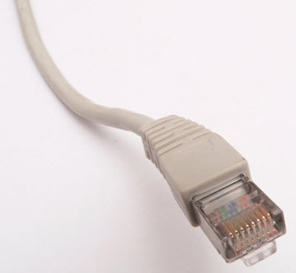
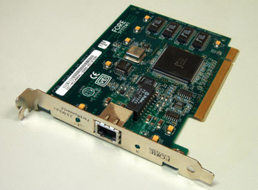

Slide 27
Network Switching Technique
When there are many devices it is necessary to develop a suitable mechanism for communicating between any two devices, one way is to use switching techniques leading to switch communication network
Different types of switching techniques are employed to provide communication between two computers. These are circuit switching, message switching and packet switching.

Slide 28
Circuit Switching
In this technique, first the complete physical connection between two computers is established and then the data is transmitted from the source computer to the destination computer. This link is allocated for the duration of the communication and no other process can be used that link during this period.
This scheme is similar to that used in the telephone system. It is a temporary communication connection established as required between the sending and receiving nodes

Slide 29
Message Switching
In this technique, the source computer sends data or the message to the switching office first which stores the data in its buffer. It then looks for a free link to another switching office and then sends the data to this office. This process is continued until the data is delivered to the destination computer.

Slide 30
Packet switching
With message switching, there is no limit on block size. In contrast, packet switching places a tight upper limit on block size. A fixed size of packets which can be transmitted across the network is specified. One logical message has to be divided into number of packets. Each packet maybe sent to its destination separately and therefore must include a source and destination address with it’s data. Each packet may take a different path through the network. A packet switching system deletes the message from memory as soon as its correct receipt at the next node is acknowledged

Slide 31
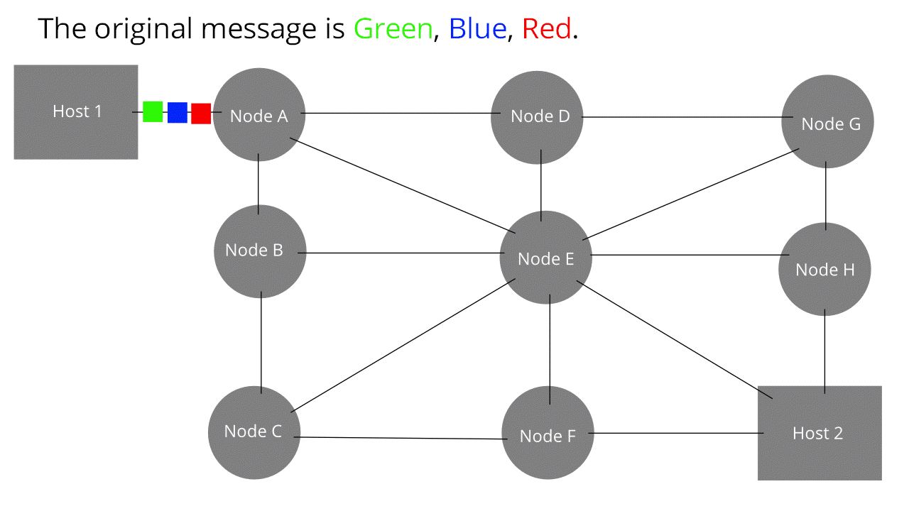

Slide 32
Transmission media
We can connect two or more workstations by using cables. The connecting cables are the transmission media between the different worsk stations. There are two main types of cables used as a transmission media. These are wire communication (twisted pair cable, coaxial cable, optical fiber cable) wireless communication (microwave, radio wave, satellite , bluetooth, Wi-Fi etc

Slide 33
Twisted Pair Cable
The most common form of wiring in data communication application is the twisted pair cable. The twisted pair cable is the transmission medium consisting of two insulated wires arranged in a regular spiral pattern. Twisted pair cable is a type of cabling that is used for telephone communication and most modern ethernet network
The twisted pair provide protection against cross talk. When electrical current flows through a wire, it creates a small circular magnetic field around the wire

Slide 34
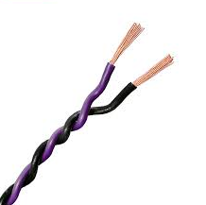
TWISTED PAIR

Slide 35
Advantages of Twisted Pair Cable
It is simple
It is easy to install and maintain
It is physically flexible
It has a low weight
It can be easily connected
It supports a large number of network devices
Reasonable cost

Slide 36
Disadvantages of Twisted Pair Cable
Because of high attenuation, it is incapable of carrying a signal over long distances without the use of repeaters.
Its low bandwidth capabilities make it unsuitable for broadband applications.
It supports maximum data rates of 1mbps without conditioning and 10mbps with conditionoing

Slide 37
Coaxial cable
This type of cable consists of solid wire core surrounded by one or more foil or wire shields, each separated by some kind of plastic insulator. The inner core carries the signal and shield provides the ground. The coaxial cable has high electrical properties and is suitable for high speed communication. While it is less popular than twisted pair, it is widely used for television signals in the form of cables. It provides a cheap mean of transporting multichannel television signals around metropolitan areas

Slide 38
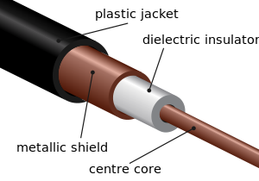
CO-OXIAL ABLE

Slide 39
Advantages of Coaxial Cable
Data transmission characteristics of coaxial cables are considerably better than those of twisted pair cables.
The coaxial cable can be used as the basis for a shared cable network
The coaxial cable can be used for broadband transmission
It offers high bandwidth of upto 400mbps

Slide 40
Disadvantages of Coaxial Cable
Expensive as compared to twisted pair cables
The coaxial cables are not compatible with twisted pair cable

Slide 41
Optical Fibre Cables
Consist of thin strands of glass or glass like material which are constructed so they carry light from a source at one end of the fibre to a detection at the other end. The light sources used are either LED or Laser Diodes (LD). They are arranged in bundles called optical cables and used to transmit light sinals over long distances

Slide 42
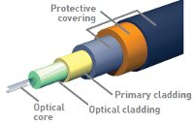
OPTICAL FIBER

Slide 43
Advantages of Optical Fibre Cable
Bandwidth is very high
It is immune to electrical and magnetic interferences i.e. noise in any form because the information is travelling on a modulated light beam
It is highly suitable for harsh industrial environment
Very good transmission technology with low error rates and low interference

Slide 44
Disadvantages of Optical Fibre Cable
Connecting either two fibres together or a light source a fibre is a difficult process
Most expensive type of cable, network hardware is also most expensive
Connection losses are a common problem
Most difficult type of cable to install due to stiffness of the outer jacket and hardness to bend around corners. Trained people are required to install this cable

Slide 45
Radio Wave
The transmission making use of radio wave is termed as radio wave transmission. Radio waves transmit music, conversations, pictures and data invisibly through the air. All radios today however use continuous sign waves to transmit information. Each different radio signal uses a different wave frequency and that is how they are all separated

Slide 46
Advantages of Radio Wave Frequency
Radio wave transmission offers mobility
It proves cheaper than digging trenches for laying cables and maintaining repeaters and cables if cable gets broken by a variety of causes
It offers freedom from land acquisition rights that are required for laying or reparing the cables
It offers ease of communication over different places

Slide 47
Disadvantages of Radio Wave Frequency
Radio waves communication is an insecure communication
Radio waves propagation is to rains thunderstorms
At low frequency, signal passes through obstacles and power fails off

Slide 48
Satellite
It is simply the communication of satellite in space with large numbers if earth stations on the ground. Users are the ones who generate signals which is processed at the earth station and transmitted to the satellite through dish antenas. In satellite communication, the earth stations consist of a satellite dish that functions as an antena and communication equipment to transmit and receive data from satellites passing overhead. These satellites act as a relay station for communication signals. The satellite accepts data/signal transmitted from an earth station, amplify them and retransmit them to another earth station. Using such a setup, data can be transmitted to the other side of the earth in only one step

Slide 49
Advantages of satellite communication
The area coverage through satellite transmission is quiet large
The lying and maintenance of inter continental cables is expensive and this is where the satellite proves to be the best alternative
The heavy users of inter continental traffic make the satellite commercially attractive
Satellite can cover large areas of the earth. This is particularly useful for sparcely populated areas

Slide 50
Disadvantages of satellite communication
Launching satellites into orbit is costly
Technological limitation preventing the deployment of large high gain antenas on the satellite platform
Overcrowding of available bandwidth due to low antena gains
High atmospheric zones 30 giga height limits carrying frequencies

Slide 51
Networking Devices
Are components used to connect computers or other electronic devices together so that they can share files or resources like printers or a fax machine

Slide 52
modem
Ordinary telephone lines cannot carry digital information, a modem changes the digital data from computers to analog data, a format that can be carried by a telephone line. In a similar manner, the modem receiving the call then changes the analog signal back into digital data that the computer can digest. This shift of digital data into analog data and back again allows two computers to speak with one another called modulation and demodulations (MODEM)

Slide 53
Ethernet Card
A type of LAN which uses a simple twisted pair cable to connect the computer to the network. That is the name ‘ethernet’ refers to the cable. When a station wants to transmit, it listens to the cable. If the cable is busy, the station waits until it goes idle, otherwise it transmits immediately

Slide 54
Hub
A hub is a network device which enables more that one computer to interconnect on a network.
Or
A hub is a network device that used to connect several computers together
There are two types of hubs; active and passive

Slide 55
There are two types of hubs,active hub and passive hub.
The active hub electrically amplifies the signal as it moves from one connected device to another. Active concentrators are used like repeaters to extend the length of a network.
The active hub can be cascaded to connect eight connections.The maximum distance covered by an active hub is about 2000ft.

Slide 56
In a passive hub,it is a passive distribution point which does not use power or active devices in a network to connect upto 4 nodes within a very short distance.
The maximum distance covered by a passive hub is about 300 ft.

Slide 57
Switch
A switch is a network device which is used to interconnect computers and/or devices on a network.
They are relatively inexpensive and offer better performance than a hub.
The switch fileters and forwards data packets across networks.

Slide 58
A switch is a device that is used to segment network into different sub-networks.
Segmenting the network into smaller sub-net prevents traffic overloading in a network,when a switch receives a data packet,it forwards the packet directly to the recepient device by looking up the MAC address.

Slide 59
Switches have a number of advantages
1)It allows dozens of devices to connect
2)It keeps traffic between two devices from getting in the way of other devices using same network.
3)It allows control of who has access to various parts of the network.
4)It allows you to monitor usage.
5)It allows communication (within your network) that is even faster than the internet.

Slide 60
Repeater
Repeater is a device that amplifies a signal being transmitted on the network.It is used in long network lines which exceed the maximum rated distance for a single run.

Slide 61
Sometimes the signals on the internet become weaker before reaching the destination node.
Repeater is used to regenerate data and voice signals.Repeater reads the incoming packet,amplifies it and transmits it to another segment of network.

Slide 62
Bridge
A bridge is used to connect two LAN’s whwich are physically seperated but logically same.Thus a bridge is used to connect LAN”s of the same type.
Everything on them is identical except the hardware system .

Slide 63
When two LAN’s are connected by a bridge,we can transmit information from one LAN to another through bridge.
A bridge between two LAN’s receives messages from both networks,checks their destination and transmits the message to the required LAN.

Slide 64
ROUTER
A router is a networking device that connects two computer networks.
On network it is not necessary that all packets will follow the same path from source to destination.
A router is a special purpose device that handles the connection between two or more networks.

Slide 65
A router connects two logically and physically different networks .
A router finds the IP address of the next router and the data is sent

Slide 66
Gateway
A gateway device connects the LAN with the internet.A gateway is directly exposed to the internet,so it should be securely configured and in and aout traffic shoud be monitored.
A gateway device connects dissimilar networks which operate at the highest layer of network abstraction.

Slide 67
Switch
Hub
A switch is more sophisticated network device and more expensive than a hub.
A switch is an intelligent device.It transmits the data packets from the source computer to only those network computers to which the data packets are originally intended.
Network security is much better with the use of switch as compared to a hub.
There is optimum utilisation of network bandwidth incase of switches.
A hub is a primitive device and is comparitively much cheaper.
Hub is a dumb device.It broadcasts the data packets to each and every network computer and not just the target computer.
Network security is weak in case of hub
Due to broadcast mechanism,there is unecessary wastage of network bandwidth which results in slow operation and data transfer speed.

Slide 68
Router
Switch
Basically a router is used to connect computers belonging to one network with those belonging to other networks. Thus, a router connects two or more different networks
Routers are much more sophisticated and intelligent network devices as compared to switches
Router works on the principle of IP address
A switch on the other hand connects different computers within one network
In comparison with router, they are less sophisticated and less intelligent
A switch works on the principle of MAC address

Slide 69
Network Topologies
The pattern of interconnection of nodes in a network is called as the topology .
A computer network topology is the physical communication scheme used by connected devices.
There are the number of factors which should be considered while choosing the topology. The most important of which are

Slide 70
Cost For a network to be cost effective, one would try to minimize installation cost. This may be achieved by using well understood media and also to a lesser extent, by minimizing the distances involved
Flexibility Because the arrangement of furniture, internal walls etc. in offices are often subject to change, the topology should allow for easy configuration of the network. This involves moving existing node and adding a new one

Slide 71
Reliability The topology chosen for the network can help by allowing the location of the fault to be detected and to provide some means of isolating it

Slide 72
Types of topologies
Star Topology This topology consists of a central node to which all other nodes are connected by a single path.
It is the topology used in most existing information network involving data processing or voice communication.
Star topology can be implemented in homes, offices or even in a building. All the computers in a star topology are connected to central devices like hub, switch or router.

Slide 73
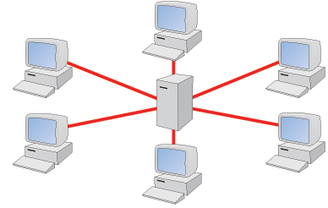
STAR TOPOLOGY

Slide 74
Advantages of Star Topology
Ease of service: The star topology has a number of concentration points. These provide easy access for service or reconfiguration of the network
One device per connection: Connection points in any network are inherently prone to failure. In the star topology, failure of a single connection typically involves disconnecting one node from an otherwise fully functional network

Slide 75
Centralized control / problem diagnosis: In this topology, central node is connected directly to every other node in the network. It means that faults are easily detected and isolated
Simple access protocol: Any given connection in a star network involves only the central node and one peripheral node. Thus, in he star network, access protocols are very simple

Slide 76
Disadvantages of Star Topology
Long cable length: because each node in star topology is directly connected to the center, the star topology necessitates a large quantity of cable. This increases installation cost and is also difficult to maintain
Difficult to expand: the addition of new nodes to a star network involves a connection all the way to the central node. Problems can arise if a longer cable length is needed or an anticipated concentration of nodes are required.
Central node dependency: if the central node in the network fails, the entire network is rendered inoperable

Slide 77
Ring Topology
A ring topology is circular in shape and every node will have one node on either side of it. It is also called as loop. In this case, each node is connected to two and only two neighboring nodes. Data is accepted from one of the neighboring nodes and is transmitted onwards to another.
In a ring network, all the communication messages travel in the same direction; whether clockwise or anticlockwise. After passing through each node, it returns to the sending node which removes it. Any damage of the cable or device can result in the breakdown of the whole network

Slide 78
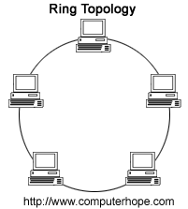
RING TOPOLOGY

Slide 79
Advantages of Ring Topology
Short cable length: In the ring topology, less connection will be needed which increase network reliability. The amount of cable needed in this topology is comparable to bus and small relative to star.
No wiring closet space required: Since there is only one cable connecting each node to its immediate neighbor, it is not necessary to allocate space in the building for a wiring closet
Suitable for optical fibre: In the ring topology, the traffic travels in one direction. It is easy to use optical fibre as medium of transmission. Use of optical fibre increases the speed of transmission

Slide 80
Disadvantages of Ring topology
a)Node failure causes network failure:Since each node in this network is connected to its neighbouring node and data travels through each node,so there is one traffic flow until defective node is removed.
b)Difficult to diagnose fault:The fact that failure of one node will affect others,so it is very diifcult to diagnose the fault in this network .We have to check each and every node to know which node is faulty
c)Network reconfiguration is difficult:The ring topoolgy causes problem when one decides to extend or modify the geographical scope of the network.

Slide 81
Bus Topology

Slide 82
It is a popular topology for data network.This consists of a single length of the transmission medium onto which the various nodes are attached.
The topology is used in traditional communication network where the host at one end of the bus communicates with several terminals attached along its length.

Slide 83
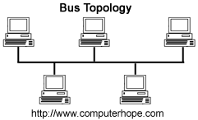
The transmission from any stations travels the length of the bus in both directions and can be received by all other stations.
The bus has terminators at each end which absorbs the signals removing it from the bus.

Slide 84
Advantages of Bus Topology
A) Short cable length:Because there is single common data path connecting all nodes,the bus topology allows a very short cable length to be used.
This decreases the installation cost and also leads to a simple,easy to maintain wiring layout

Slide 85
B)easy to extend:Additional nodes can be connected to an existing bus network at any point along its length.
C)Resilient architecture:The bus architecture has an inherent simplicity that makes it very reliable from a hardware point of view.

Slide 86
Disadvantages of Bus Topology
A)Fault diagnois is difficult:Although the bus topology is very simple,but in this topology,fault detection is very difficult.
Control of the network is not centralised in any particular node.This means that detection of a fault may have to be performed from many points in the network.

Slide 87
B)Fault isolation is difficult:If the fault in the node is detected,the node can simple be removed,but if the fault is in the network medium itself,an entire segment of the bus must be disconnected.
C)Repeater configuation:When a bus type network has its backbone inteneded using repeaters,reconfiguration may be necessary.
This may involve tailoring cable lengyth,adjusting terminators etc.

Slide 88
D)Nodes must be intelligent:Each node on the network is directly connected to the central bus.This means that some way of deciding who can use the network at any given time must be performed in each node.

Slide 89
Tree Topology
The tree topology is modified form of the bus topology .The shape of the network is that of an inverted tree with the central root branching and sub branching of the network.
Transmission in this topology takes place the same way as in the bus topology.Only difference in this network and the bus is the presence of the root

Slide 90
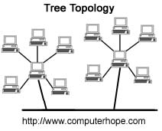
Tree Topology is a combination of the star and bus topology.
A tree topology connects one star network to other star networks.
if the main cable or trunk between each of the two star topology networks was to fail, those networks would be unable to communicate with each other. However, computers on the same star topology would still be able to communicate with each other.

Slide 91
Advantages of Tree Topology
A)it is possible to form point-to point connections with tree topology.
B)Tree is of its very nature,divided into sub-units,it is easier to add nodes or branches to it.
C)Tree topology makes it easier to isolate a defective node.

Slide 92
Disadvantages of Tree Topology
A)In this typeof topology the length of the network depends on the type of cable utilised to form the network.
B)The entire tree topology would fail if the central node fails,which is the backbone of the network.
C)It is expensive as more hubs and cables are required to install the network.

Slide 93
Network Protocols

Slide 94
HTTP(Hyper Text Transfer Protocol)
It is the set of rules or protocol that governs the transfer of hyper text betweeen two or more computers.
Hyper text is a text that is specially coded using a standard system called Hyper text markup language or HTML.
The HTML codes are used to create links.These links can be textual or graphic and when clicked on,can link the user to another resource such as other HTML files,graphics,animations,sound etc.

Slide 95
HTTP is based on the client server principle.HTTP allows computer A (the client) to establish a connection to computer B(the server) and make a request.
The server accepts the connection initiated by the client and sends back a response.A HTTp request identifies the resource that the client is interested in and tells the server what action to take on the resource/data.This data can be just about anything including HTML,text ,images,program and sound.

Slide 96
FTP(File Transfer Protocol)
FTP is part of TCP/IP protocol.It is the protocol or set of rules which enable files to be transferred between computers.
FTP is a powerful tool which allows files to be transferred from computer A to computer B or vice versa.

Slide 97
FTP works on the client server principle.
A client program enables the user to interact with the server in order to access the information and services on the server computer.
Files that can be transferred are stored on a computer called FTP server.
To access these files,an FTP client program is used.

Slide 98
This is an interface that allows the user to locate the files to be transferred and initiate the transfer process.
The basic steps to use FTP server
1)Connect to FTP server
2)Navigate the file structure and find the file you want
3)Transfer the file

Slide 99
The basic functions of the FTP are
1)Transferring text and binary files
2)Appending,deleting and renaming files
3)Reading and making directories
4)Supply file information
5)Provide knowledge about password
6)Transferring large files

Slide 100
TCP/IP(Transmission Control Protocol/Internet Protocol)
An internet connection is usually accompolished using inetrnational standard collective by called as Transmission control protocol(TCP/IP)
TCP/IP is actually a collection of protocols or rules that govern the way data travels from one machine to another across a network.The internet is based on TCP/IP. TCP/IP has two major components TCP and IP.

Slide 101
Internet Protocol(IP)
The basic functions are
A)Envelopes and addresses the data.
B)Enables the network to read the enevelope and forward the data to its destination
C)Define how much data can fit in a single envelope(a packet)

Slide 102
Transmission Control Protocol(TCP)
The basic functions are
A)we can create clients
B)We can create servers
C)Breaks data into packets that the netwok can handle effecienty
D)Verifies that all packets arrive at their detsination
E)Reassembles the data.

Slide 103
Telnet(Remote Login)
Login means to connect to a host computer at the public access site.Remote login means to connect the network at the remote station without any network.
This remote login takes place through TELNET.

Slide 104
Telnet is a network application that is used to login to one computer on the internet from another.
It is similar to establishing a conventional dial up connection between two computers using modem and dial up telephone line.
A telnet session is established by using a telent client software .

Slide 105
A user requests a session to be established with a remote host by providing its host name or IP address.
The telnet client software locates one host over the internet and establishes a remopte login session to that host.

Slide 106
Internetworking
The internet is a global connection of peoples computers which are linked together by cables and telephone lines making communication possible among them in a common language.
In simple words internet is a global connection of interconnected networks.When more than two networks are connected and the data comminciation is done across this network,it is called internetworking.

Slide 107
HOST
A computer system which provides general user services over the network is called the host computer.

Slide 108
Backbone Network
LAN covers limited area and has proper connection with cable.But sometimes it is required to connect a number of LAN’s to share data.
When these LAN’s are conencted,it becomes a WAN .This type of connection behind the LAN is called a backbone network.

Slide 109
Firewall
A firewall is a computer system or groups of computer systems which re-inforce information security between two networks.
These networks are referred to as an internal network and an outside network.
All information passing between these two networks goes through this firewall.

Slide 110
That makes the firewall an ideal point at which to impelement filetring,monitoring and logging of session between one network and another.

Slide 111
Cookies
A cookie is a small file that a web-server can store on your machine.
Its purpose is to allow a web-server to personalize a web page depending on whether you have been to that website before and what you may have told it during the previous sessions.

Slide 112
Web-services
HTML(Hyper text markup language)
The world wide web is an exciting medium bringing information,images,advertising,and so many things to every desktop.
Everything we see on the web is a document written in a special language called HTML.

Slide 113
This language tells the web-browser how to display text,pictures and links on the screen.
HTML is not a programming language ,it is a markup language.
A markup language is a set of markup tages which describe web-pages.

Slide 114
DHTML(Dynamic Hypertext markup language)
DHTML is typically used to describe the combination of HTML,style sheets and scripts that allow documents to be animated.
DHTML is a term describing the art of making dynamic and interactive webpages.
DHTML is an art of combining HTML,javascript and others.

Slide 115
Domain Name
A domain name is a way to identify and locate computers connected on the internet.
No two organisations can have the same domain name.
A domain name always contains two or more components seperated by dots.

Slide 116
DNS name is nothing but resolving host names such as www.yahoo.com to their corresponding IP addresses.

Slide 117
Uniform Resource Locator(URL)
URL stands for uniform Resource Locator which means it is a uniform way to locate a resource on the internet.
The URL specifies the address of a file and every file on the internethas a unique address.

Slide 118
Web seftware such as browser use the URL to retreive a file from the computer on which it resides.
The URL provides an addressing scheme which allows the browser to request just about any document or web page located anywhere on the internet.

Slide 119
The actual URL is a set of four numbers seperated by periods.
An example of this would be 202.147.23.8
These are difficult for humans to remember ,so addresses are represtened in alpha-numeric form that is more descriptive and easy to remember .
Thus the URL of any site would have URL as 209.164.80.192 can also be written as www.microsoft.com.

Slide 120
The internet domain name system transaltes the alpha numeric adresses to numeric.
A URL normally takes the form
<protocol>://<web-server-name>/<directoryname>/<filename>
The first part of the URL specifies the transfer protocol that is starting at the left most portion of the URL upto the colon ,tells the browser what type of server it will connect to and what protocol to use.

Slide 121
The second part of the URL is a full qualified domain name.
The third part of the URL is ac full path name for a particular web-page.
The path name is always preceeded by a single slash after the domain name.
Eg:http://www.microsoft.com/abc/file.html
Protocol Name
Domain Name
DIR
File Name

Slide 122
IP addresses
To find a given piece of hardware,it is given an IP address.It looks like 192.168.0.1.
There are always four numbers between 0 and 254 seperated by periods.
The IP address is just like a phone number.Once you have a phone number,we can reach them

Slide 123
The phone system has logic bulit into it to find the country code,area code,exchange etc,similarly the internet can find a computer by its IP address.
When a computer is attached to the internet,it is assigned an IP address either automatically or by a program called DHCP(dynamic host configuartion protocol) server or manually by a system administrator.

Slide 124
IP addresses are in XXX.XXX.XXX.XXX format ,where each group of X is a number from 0 to 255.
IP addresses iddentify the host computer so that the packet of information reaches the correct computer.
We have to type the IP address when we configure our computer for connection to the internet.

Slide 125
Characteristics of IP address
A)IP address are unique.
B)No two machines can have the same IP address.
C)IP address are also global and standardized
D)All machines connected to the internet agree to use the same scheme for establisghing an address.

Slide 126
World Wide Web(WWW)
The world wide web is an interent service based on a common set of protocols which allow a particularly configured server computer to distribute documents across the internet in a standard way.

Slide 127
Web server
A web server is simply a computer with an internet connection that runs software designed to send out HTML pages and other file formats.
The server computer should be relatively high speed connection on the internet and powerful enough to deal with a number of simeltenous connections from the internet.

Slide 128
Web -site
A website is a collection of web-pages belonging to a particular person or an organisation.Each document on the website may contain only text or a combination of text,images or multimedia is called webpage.

Slide 129
Web-Page
A webpage is a single unit of information often called a document that is available via the world wide web.
A web page is an HTML document that is stored on a webserver which has a URL .As a result it can be accessed via the web.

Slide 130
Web-Browser
A web-browser is a client application that requests,receives and displays HTML pages.It is a program that our computer runs to communicate with the web –server on the internet,which enables it to download and display the web-pages that we request.
Some of the most popular web-browsers are google-chrome,mozilla firefox,netscape navigator,opera,apple safari etc.

Slide 131
Chatting
This is one of the most important services on the internet where one user can chat with another user who are logged in at that time.
The chat service uses specialised software that allows the user to type some comment in one window and receive the reply in another from someone who is accessing the same software.
Chat is a real time communication between two users via computers

Slide 132
Video -Conferencing
Video conferencing is talking to another person via a microphone and speakers connected to the computer.
Video conferencing is sending your image and voice to one or more people through the camera and microphone attached to your computer and receiving pictures and voices back.

